Slide 1
Sales Performance Analysis

Slide 2
AGENDA
ABC Electronics wants to assess its sales performance across different regions and product categories. The management needs a summarized report with visual insights to identify top-performing regions, products, and trends.
The task is to clean the data, analyze it using formulas, and create a basic dashboard that provides actionable insights

Slide 3

Business use cases

Slide 4
CURRENT MARKET ANALYSIS
Identifying top-performing regions and product categories.
Understanding the impact of discounts on sales and profit margins.
Providing actionable insights for marketing and inventory management.
Monitoring key sales metrics for strategic decision-making.

Slide 5
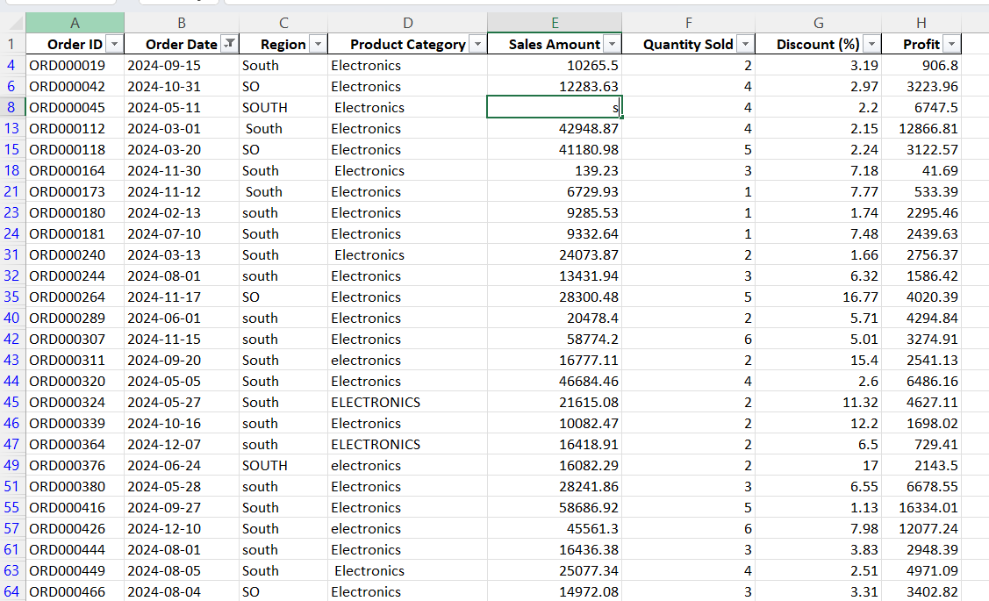
TASK 1: SEARCHING AND FILTERING DATA
Used filter option under sort and filter to search data in each column.
Filtered the dataset to find all orders placed in the "South" region for the "Electronics" category within the last year.

Slide 6
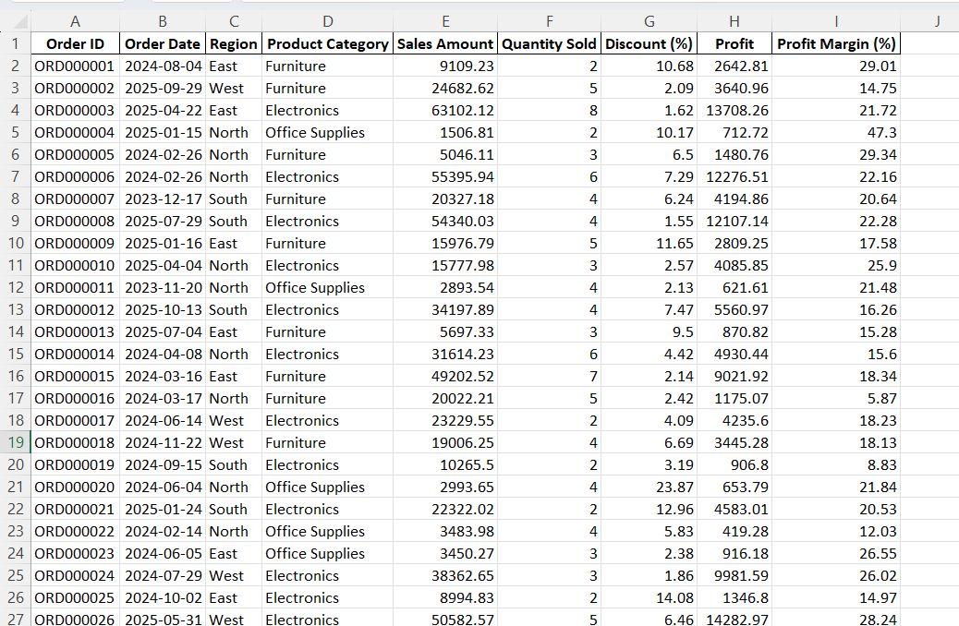
TASK 2: DATA CLEANING WITH TEXT FUNCTIONS
Used TRIM, UPPER, PROPER functions to clean the data.

Slide 7
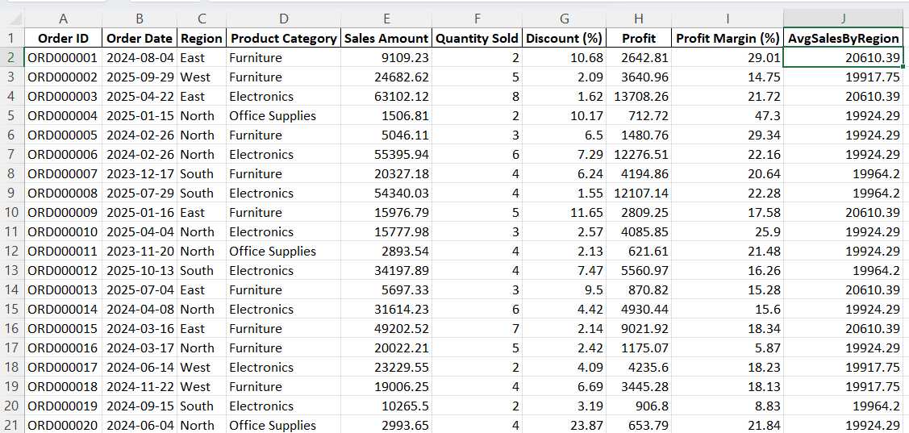
TASK 3:MERGING DATA
Used the below formula to calculate avgsalesbyregion and merged it back to data set
=XLOOKUP([@[Region]], tblRegionAvg[Region], tblRegionAvg[AvgSales])

Slide 8
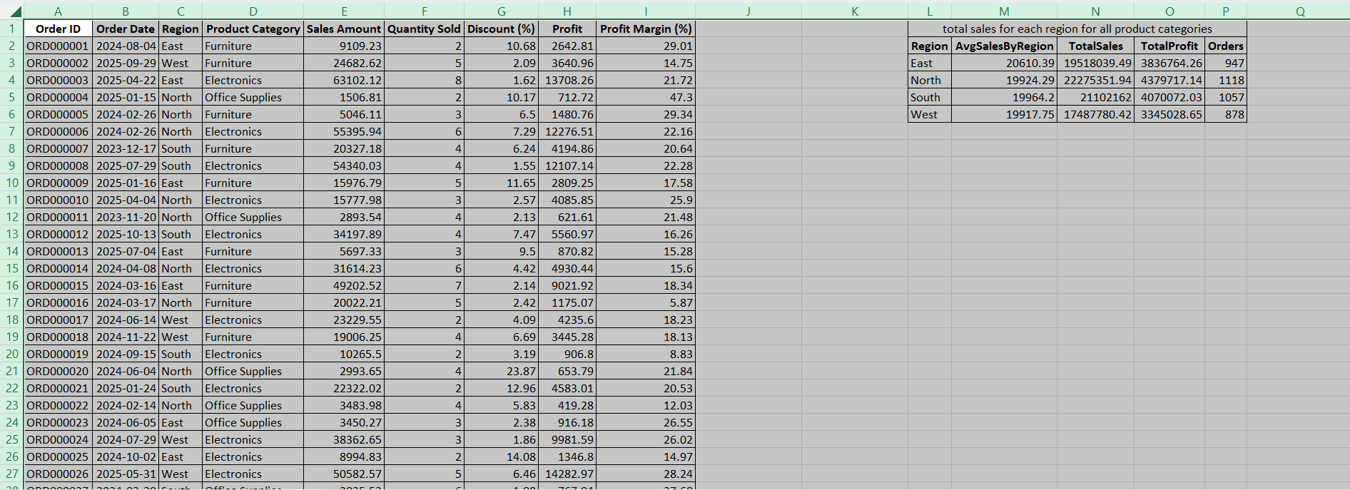
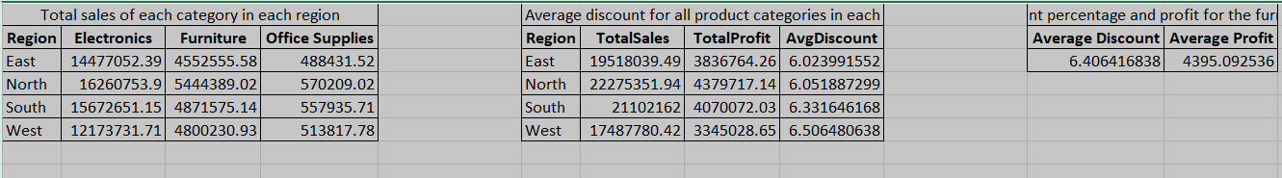
TASK 4: EXCEL FORMULAS
Total sales by region: =SUMIFS(tblSales[Sales Amount], tblSales[Region], "North")
Average discount for Furniture: =AVERAGEIFS(tblSales[Discount (%)], tblSales[Product Category], "Furniture")
Average profit for Furniture: =AVERAGEIFS(tblSales[Profit], tblSales[Product Category], "Furniture")
Count orders: =COUNTIFS(tblSales[Region], "South", tblSales[Product Category], "Electronics")

Slide 9
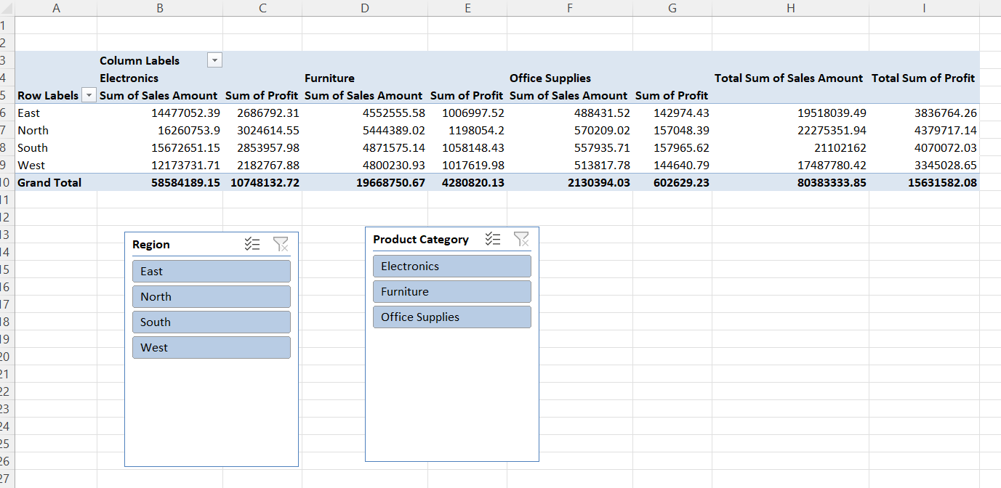
TASK 5:PIVOT TABLES
Created a Pivot Table to summarize total sales and profit by region and product category. Added slicers to filter by region or category dynamically.

Slide 10
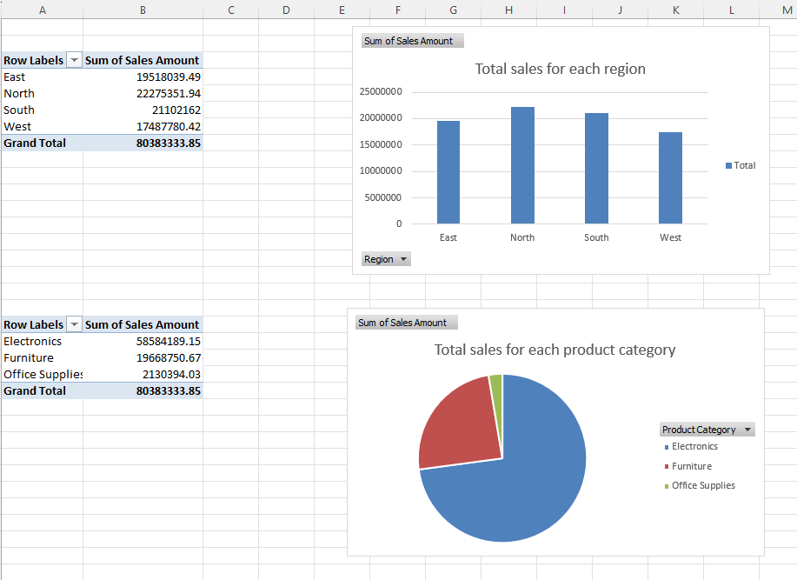
TASK 6:CHARTS
Created a bar chart showing total sales for each region.
Created a pie chart showing the percentage contribution of each product category to total sales.

Slide 11
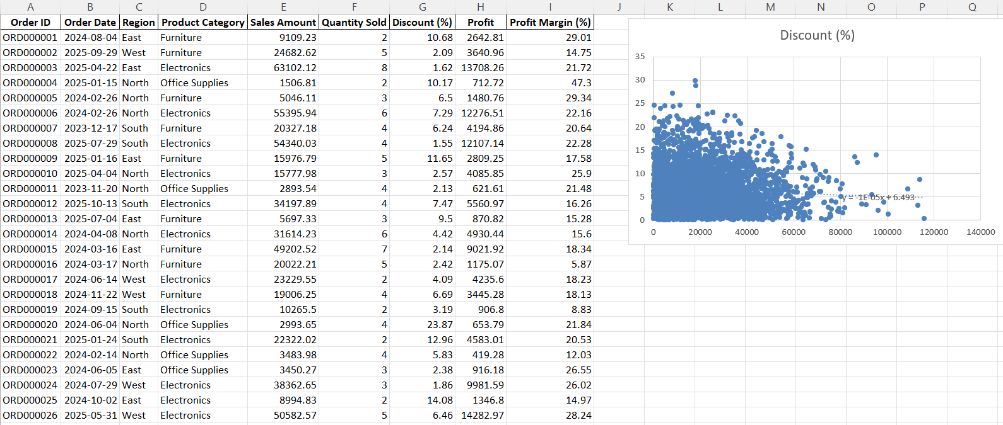
TASK 7: REGRESSION ANALYSIS
Performed a simple regression analysis to understand the impact of Discount (%) on Sales Amount. Used a scatter plot to visualize the relationship.

Slide 12
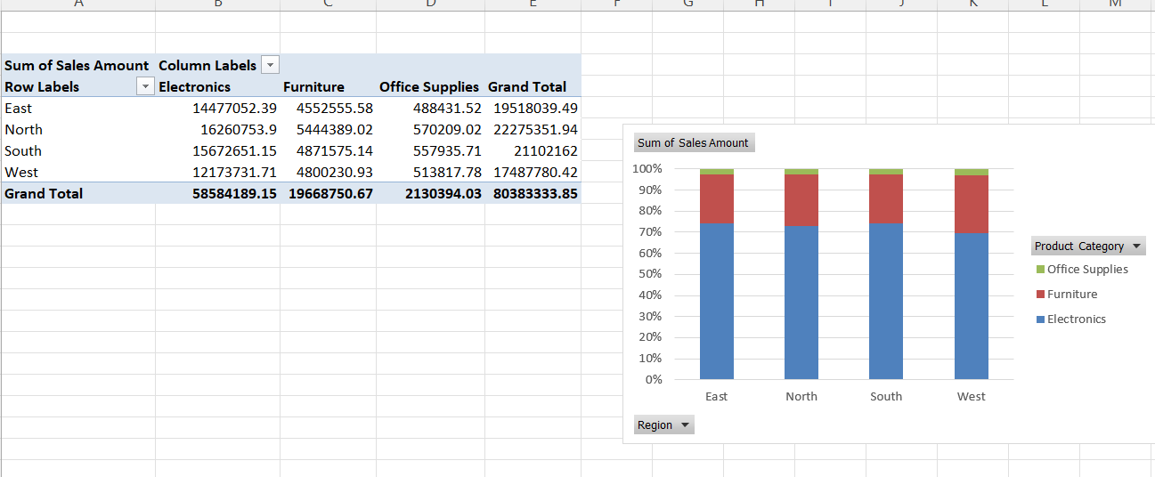
TASK 8:STACKED BAR CHART
Created a stacked bar chart showing total sales by region and product category.

Slide 13
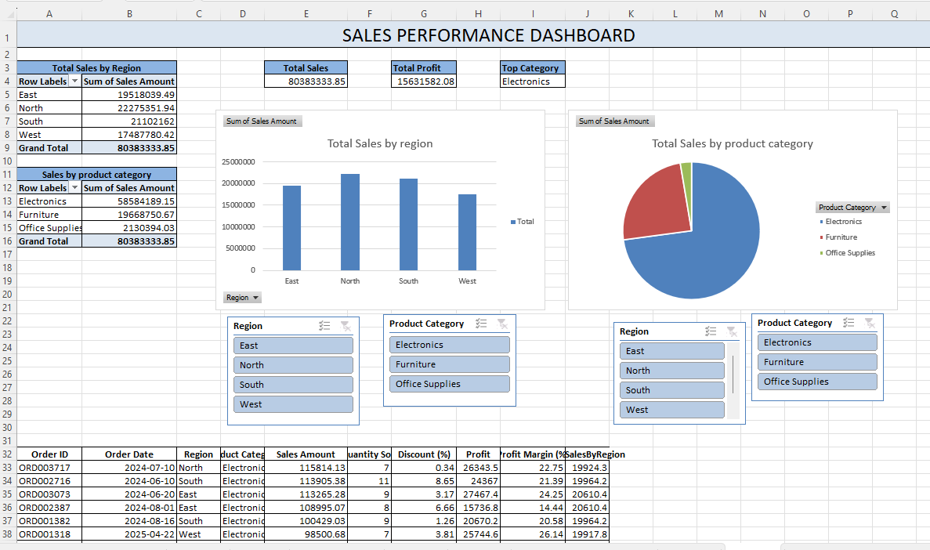
TASK 9:BASIC DASHBOARD
Created a dashboard showing key metrics (total sales, total profit, highest-selling product category).
Added interactive elements like slicers or dropdowns for dynamic filtering.

Slide 14
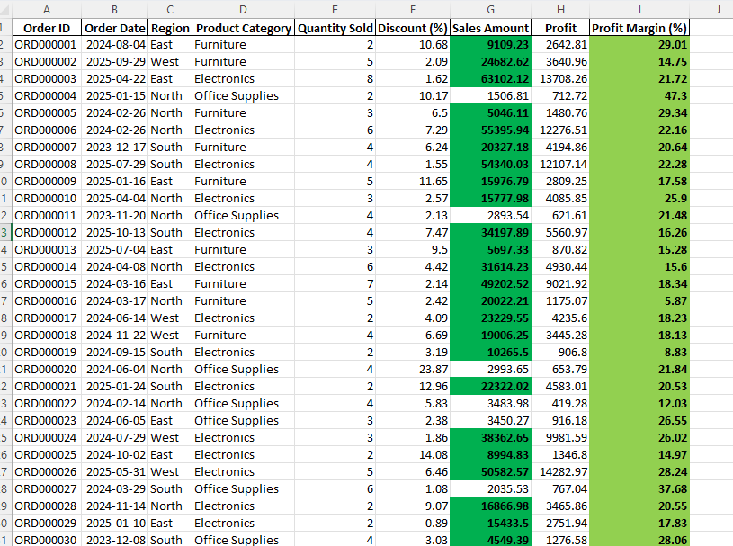
TASK 10:HIGHLIGHT HIGH PERFORMERS (CONDITIONAL FORMATTING)
Used conditional formatting to highlight orders with a profit margin greater than 50% or sales amounts above ₹4000.

Slide 15
Thank you

